Slide 1
Basic Concepts in ML modelling
By: L Vinay Rajiv Reddy

Slide 2
Training Accuracy:
The trained data is been subjected to the model.
Then the accuracy is obtained.

Slide 3
Bias-Variance Trade-Off:
While building a model it’s importance to understand prediction errors (bias & variance)…
Bias – Training Error.
Variance – Testing Error.

Slide 4
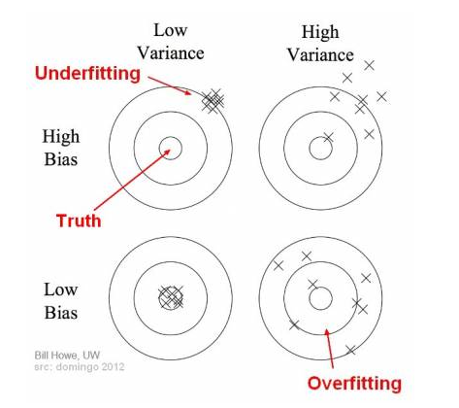
Bias and variance using bulls-eye diagram

Slide 5
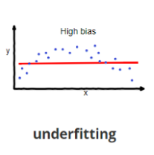
Under Fitting:
When a model isn’t able to capture the underlying patterns of data.
High bias & Low variance.
When we have less amount of data to build an accurate model.
While trying to separate non linear data with a linear model.

Slide 6
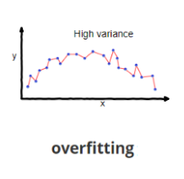
Over Fitting:
When model captures noise along with underlying data.
Low bias. High Variance.
Only predicts trained data well, but can’t generalizes when a new(testing) data comes.
Decision trees are prone to it.

Slide 7
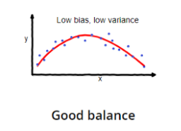
Why Bias-Variance Trade-Off ?
If our model is too simple and has very few parameters → Under Fitting .
if our model has large number of parameters → Over Fitting.
So a need for balanced fitting is there.

Slide 8
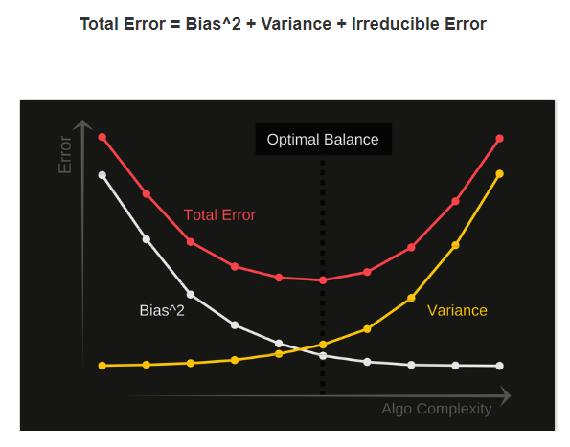
When we attain balanced fitting ?

Slide 9
How to attain balanced fitting ?
Hyper parameter Tuning.
Using trail and error method.
Computational time α (N*d ) → Time taking.

Slide 10
Cross Validation Testing
100% Data
770% of data for training
30% of data for testing

